Slide 1

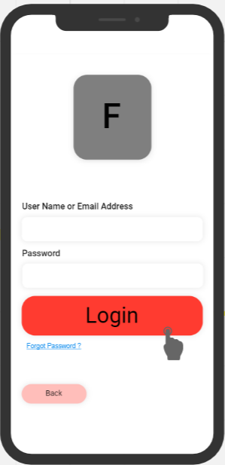

Product Demonstration Amin Abdi

Slide 2
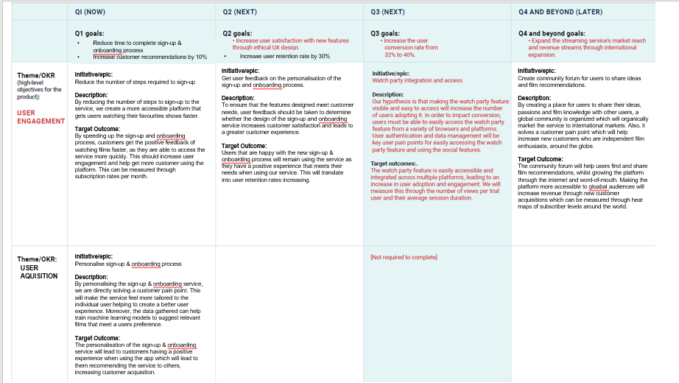

Slide 3
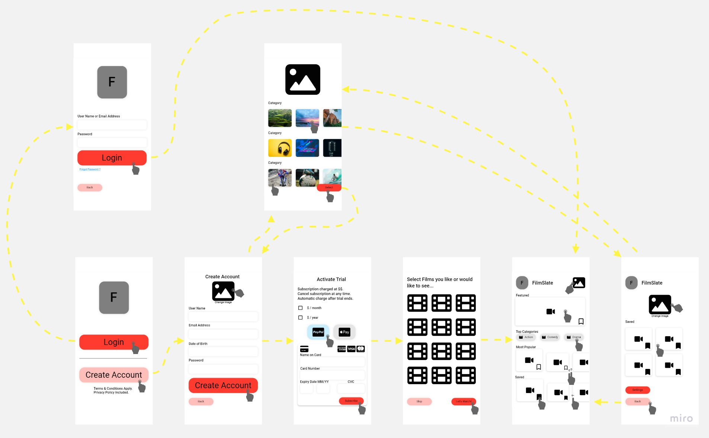

Slide 4
Success Metrics
Reduced time to complete sign-up & onboarding process
30% of tested participants would recommend the product
Over 50% of tested participants would stay subscribed to the service after trial period

Slide 5
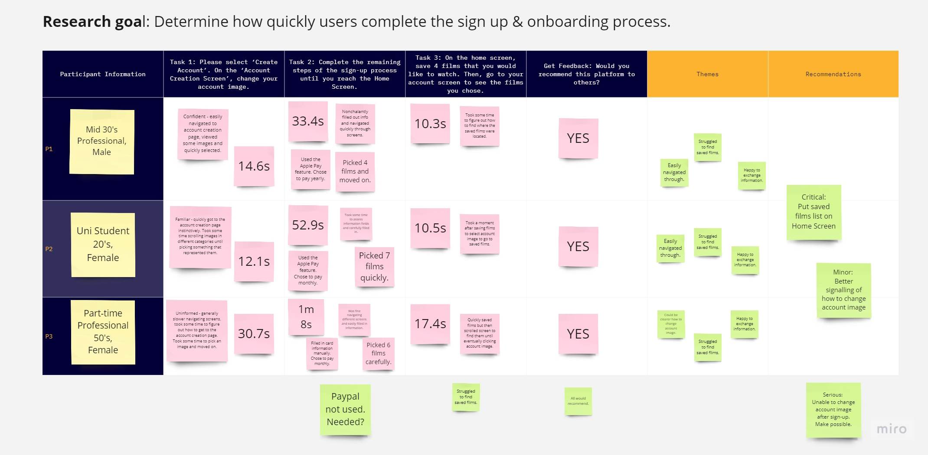
Usability Testing

Slide 6
NEXT STEPS
Progress design into high-fidelity model & continue usability testing
Evaluate best launch strategies
Begin watch party development

Slide 7
Questions?

